Slide 1
Today’s Objective
1. Stack

Slide 2
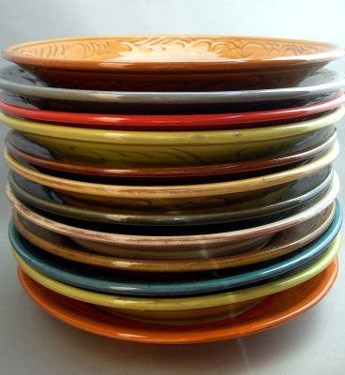
Stacks
Access is allowed only at one point of the structure, normally termed the top of the stack
access to the most recently added item only
Operations are limited:
push (add item to stack)
pop (remove top item from stack)
top (get top item without removing it)
isEmpty
Described as a "Last In First Out" (LIFO) data structure

Slide 3
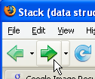

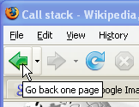
Uses of Stacks
The runtime stack used by a process (running program) to keep track of methods in progress
Search problems
Undo, redo, back, forward

Slide 4
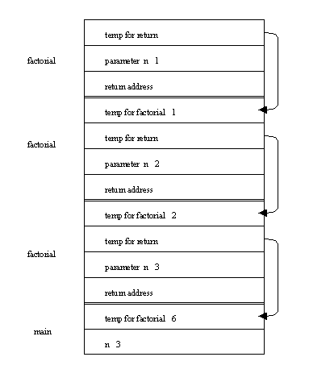
Recursion

Slide 5
Batch computer programs
Program A calls subprogram which calls sub program B which calls sub program C

Slide 6
Pseudocode for Array Implementation
Push(stack,top,maxstk,item)
This procedure pushes an item onto stack
1. if top:=max then:
print:overflow , return
2. Set top:=top+1
3. Set stack[top]:=item
4. Return

Slide 7
Pseudocode for Array Implementation
Pop(stack,top,item)
This procedure deletes the top element of stack and assigns it to the variable item
If top=0 then:
print: underflow and return
Set item=stack[top]
Set top:=top -1
return

Slide 8
Algorithm for Linked List Implementation
Algorithm push(stack,data)
Allocate new node
Store data in new node
Make current top node the second node
Make new node the top
Increment stack count
end push

Slide 9
Algorithm for Linked List Implementation
Algorithm pop(stack,dataOut)
If(stack empty)
Report
else
Set dataOut to data in top node
Make second node the top node
Decrement satck count
endif
end pop

Slide 10
Some Applications are
Reverse the series
Decimal to binary conversion
Pallindrome checking
8 Queens problem with backtracking
Checking balanced paranthesis
Infix to postfix expression
Evaluation of postfix expression

Slide 11
What is easier for computing systems
The expression that you see above is known as Infix Notation.
It is a convention which humans are familiar with and is easier to read.
But for a computer,calculating the result from an expression in this form is difficult.
Hence the need arises to find another suitable system for representing arithmetic expressions which can be easily processed by computing systems.
The Prefix and Postfix Notations make the evaluation procedure really simple.
But since we can't expect the user to type an expression in either prefix or
postfix, we must convert the infix expression (specified by the user) into
prefix or postfix before processing it.
This means that your program would have to have two separate functions,
To convert the infix expression to post or prefix and the
To compute the result from the converted expression.

Slide 12
X1 OP X2
X1 X2 OP
OP X1 X2

Slide 13
Postfix Examples
Why ? No brackets necessary !
Infix | Postfix | Evaluation
2 - 3 * 4 + 5 | 2 3 4 * - 5 + | -5
(2 - 3) * (4 + 5) | 2 3 - 4 5 + * | -9
2- (3 * 4 +5) | 2 3 4 * 5 + - | -15

Slide 14
Algorithm for Infix to Postfix
1) Examine the next element in the input.
2) If it is operand, output it.
3) If it is opening parenthesis, push it on stack.
4) If it is an operator, then
i) If stack is empty, push operator on stack.
ii) If the top of stack is opening parenthesis, push operator on stack
iii) If it has higher priority than the top of stack, push operator on stack.
iv) Else pop the operator from the stack and output it, repeat step 4
5) If it is a closing parenthesis, pop operators from stack and output them until an opening parenthesis is encountered. pop and discard the opening parenthesis.
6) If there is more input go to step 1
7) If there is no more input, pop the remaining operators to output.

Slide 15
algorithm:
set operator_stack to empty stack
while (not end of input)
symbol = next input
if (symbol is operand)
add symbol to postfix string
else
while (operator_stack not empty and top element
has higher precedence than symbol)
pop top element and add it to postfix string
push symbol onto operator_stack
while (operator_stack not empty)
pop top element and add it to postfix string

Slide 16
Suppose we want to convert 2*3/(2-1)+5*3 into Postfix form,
Expression | Stack | Output
2 | Empty | 2
* | * | 2
3 | * | 23
/ | / | 23*
( | /( | 23*
2 | /( | 23*2
- | /(- | 23*2
1 | /(- | 23*21
) | / | 23*21-
+ | + | 23*21-/
5 | + | 23*21-/5
* | +* | 23*21-/53
3 | +* | 23*21-/53
 | Empty | 23*21-/53*+
So, the Postfix Expression is 23*21-/53*+

Slide 17

Infix to postfix conversion
infixVect
( a + b - c ) * d – ( e + f )
postfixVect

Slide 18
Infix to postfix conversion
stackVect
infixVect
a + b - c ) * d – ( e + f )
postfixVect
(

Slide 19
Infix to postfix conversion
stackVect
infixVect
+ b - c ) * d – ( e + f )
postfixVect
a
(

Slide 20
Infix to postfix conversion
stackVect
infixVect
b - c ) * d – ( e + f )
postfixVect
a
+
(

Slide 21
Infix to postfix conversion
stackVect
infixVect
- c ) * d – ( e + f )
postfixVect
a b
+
(

Slide 22
Infix to postfix conversion
stackVect
infixVect
c ) * d – ( e + f )
postfixVect
a b +
-
(

Slide 23
Infix to postfix conversion
stackVect
infixVect
) * d – ( e + f )
postfixVect
a b + c
-
(

Slide 24
Infix to postfix conversion
stackVect
infixVect
* d – ( e + f )
postfixVect
a b + c -

Slide 25
Infix to postfix conversion
stackVect
infixVect
d – ( e + f )
postfixVect
a b + c -
*

Slide 26
Infix to postfix conversion
stackVect
infixVect
– ( e + f )
postfixVect
a b + c - d
*

Slide 27
Infix to postfix conversion
stackVect
infixVect
( e + f )
postfixVect
a b + c – d *
-

Slide 28
Infix to postfix conversion
stackVect
infixVect
e + f )
postfixVect
a b + c – d *
(
-

Slide 29
Infix to postfix conversion
stackVect
infixVect
+ f )
postfixVect
a b + c – d * e
(
-

Slide 30
Infix to postfix conversion
stackVect
infixVect
f )
postfixVect
a b + c – d * e
+
(
-

Slide 31
Infix to postfix conversion
stackVect
infixVect
)
postfixVect
a b + c – d * e f
+
(
-

Slide 32
Infix to postfix conversion
stackVect
infixVect
postfixVect
a b + c – d * e f +
-

Slide 33
Infix to postfix conversion
stackVect
infixVect
postfixVect
a b + c – d * e f + -

Slide 34
Write the following infix expression in their postfix forms
A+B *C
(A+B)*C+D+E*F-G
3+4*5/6
(300+23)*(43-21)/(84+7)

Slide 35
Evaluation of the postfix expression
623+-382/+*2^3+
scan from left to right: 6,2,3,+
- apply + to 2 and 3: 6,5
- scan further: 6,5,-
- apply - to 6 and 5: 1
- scan further: 1,3,8,2,/
- apply / to 8 and 2: 1,3,4
- scan further: 1,3,4,+

Slide 36
623+-382/+*2^3+, currently: 1,3,4,+
- apply + to 3 and 4: 1,7
- scan further: 1,7,*
- apply * to 1 and 7: 7
- scan further: 7,2,^
- apply ^ to 7 and 2: 49
- scan further: 49,3,+
- apply + to 49 and 3: 52

Slide 37
Scan from left to right
push scanned operands on a stack
if an operator was scanned, apply it to the
two topmost operands on the stack and
replace them by the result

Slide 38
Algorithm
operand_stack = empty stack
while (not end of input)
symbol = next input symbol
if (symbol is operand)
push(operand_stack, symbol)
else
operand2 = pop(operand_stack)
operand1 = pop(operand_stack)
result = apply symbol to operand1 and operand2
push(operand_stack, result)
return pop(operand_stack)

